Slide 1
Java Plays : Eclipse Lab 3
Remote Development and Debugging using Eclipse
IBM
ECOD

Slide 2
AGENDA
Purpose of This Lab
Step 1: Enable Remote Development Mode in Eclipse
Step 2: Push Incremental Changes
Step 3: Test with Postman
Step 4: Enable Local Debug Mode in Liberty Profile
Step 5: Test Local Debug Session
Summary
Java Plays: Remote Development and Debugging using Eclipse

Slide 3
Purpose of This Lab
In this lab, you will learn how to enable remote development of a project that has been linked to Bluemix server. When remote development mode is turned on, you can incrementally push changes to Bluemix server, without restarting the application!
Also we will explore how to debug an application deployed on WebSphere Liberty server, locally. Debugging mode helps to pin point specific code where an error happens when a user request or server response is sent.
Java Plays: Remote Development and Debugging using Eclipse

Slide 4
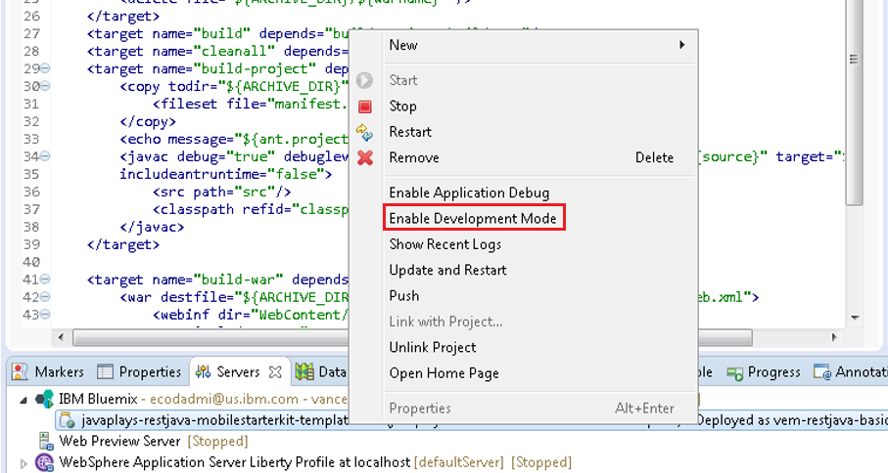
Step1 : Enable Remote Development Mode in Eclipse
In Servers view, right click on project, select Enable Development Mode
Java Plays: Remote Development and Debugging using Eclipse

Slide 5
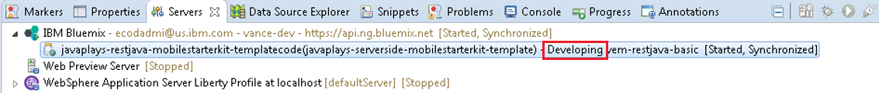
Output – Success Message – Bluemix server is in Developing mode
Java Plays: Remote Development and Debugging using Eclipse

Slide 6
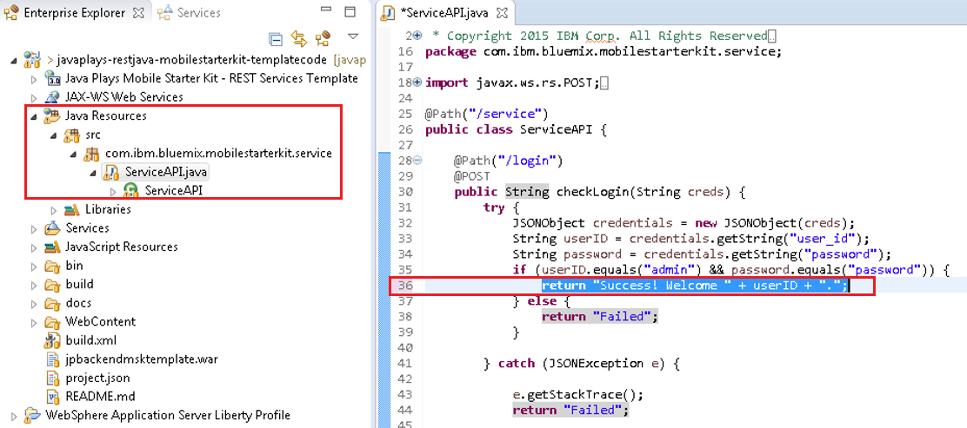
In Enterprise Explorer, expand Java Resources > src > com.ibm.bluemix.mobilestarterkit.service > ServiceAPI.java
Make code changes in ServiceAPI.java
Save
Java Plays: Remote Development and Debugging using Eclipse

Slide 7
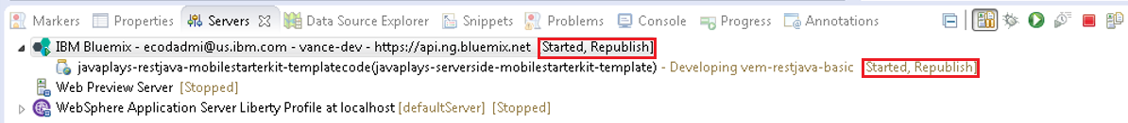
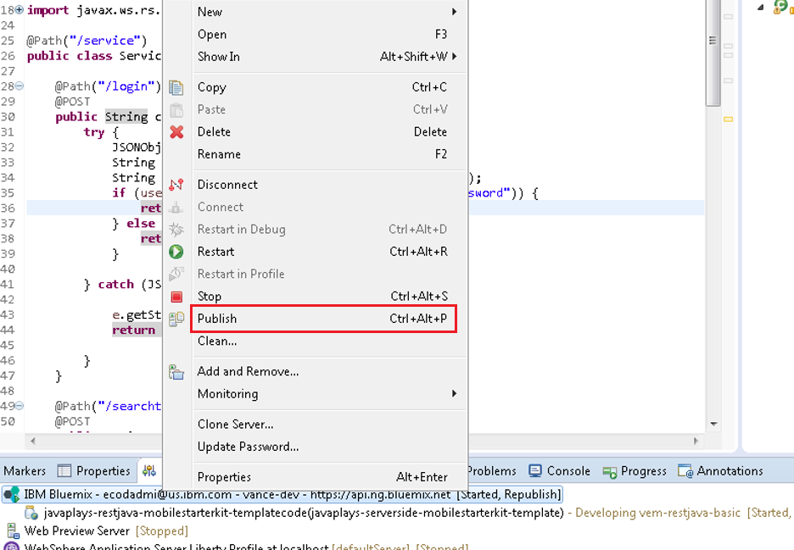
Step 2: Push Incremental Changes
In Servers tab, observe Server status [Started, Republish]
Right click on Bluemix server, and select Publish
Java Plays: Remote Development and Debugging using Eclipse

Slide 8
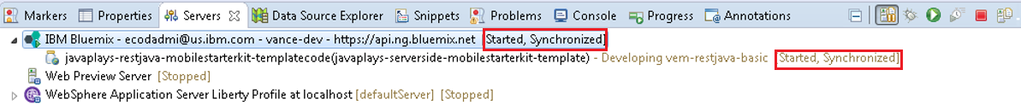
Output – Observe Bluemix server status [Started, Synchronized]
Java Plays: Remote Development and Debugging using Eclipse

Slide 9
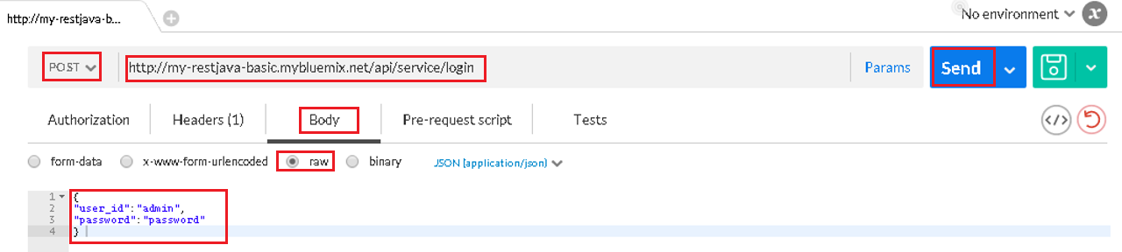
Step 3: Test with Postman
Open Postman extension page in Chrome browser
Change to POST method
Enter http://<your hostname>.mybluemix.net/api/service/login
Click Body tab
Select raw
Enter the following
  {
  “user_id”: “admin”,
  “password”: “password”
  }
Click Send
Java Plays: Remote Development and Debugging using Eclipse

Slide 10
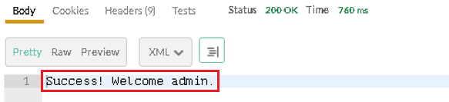
Success Message
Java Plays: Remote Development and Debugging using Eclipse

Slide 11
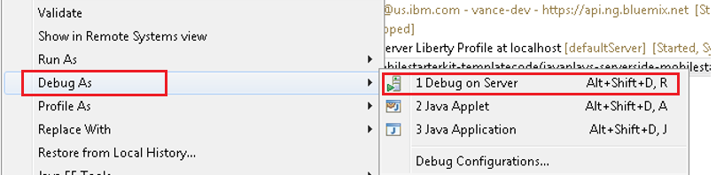
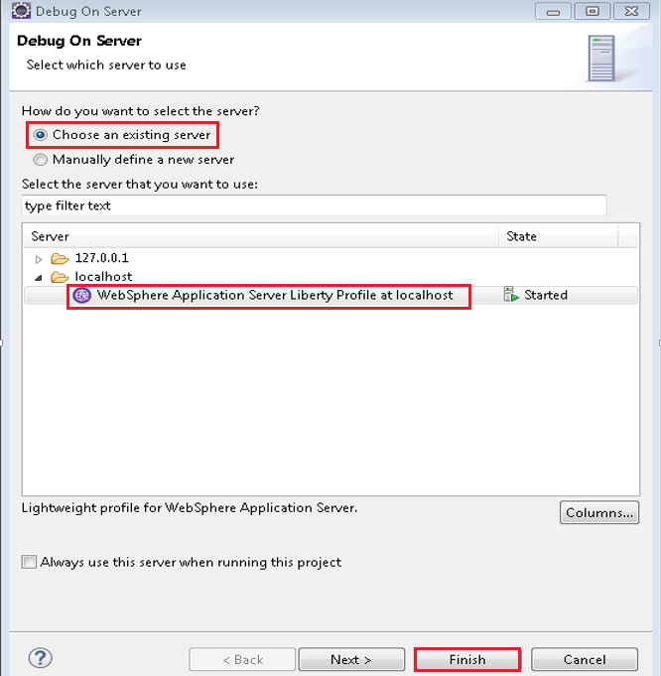
Step 4: Enable Local Debug Mode in Liberty Profile
In Enterprise Explorer view, right click on project, select Debug As > Debug on Server
Choose an existing server
Select WebSphere Application Server Liberty Profile at localhost
Click Finish
Java Plays: Remote Development and Debugging using Eclipse

Slide 12
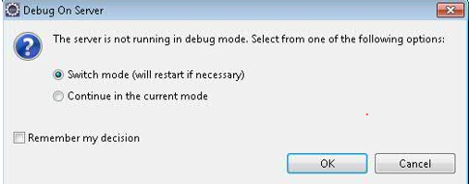
Switch to Debug mode
Click OK
Java Plays: Remote Development and Debugging using Eclipse

Slide 13
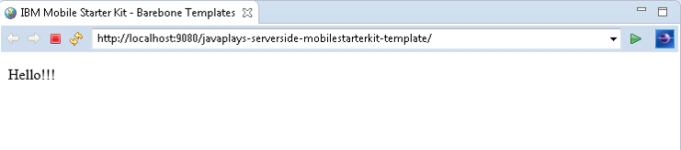
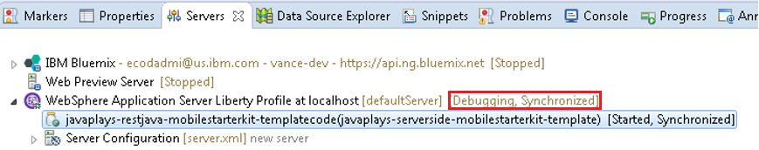
Success Message – Webpage displayed successfully
Observe local WebSphere Liberty Server status [Debugging, Synchronized]
Java Plays: Remote Development and Debugging using Eclipse

Slide 14
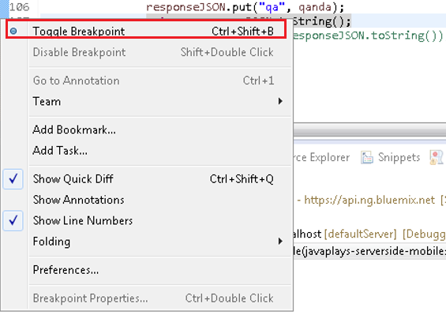
In Enterprise Explorer view, open ServiceAPI.java, and set a breakpoint
2 ways to set breakpoint:
  Right click on the blue sidebar (on the left of line number) and select toggle breakpoint
  OR
  Double click on the blue sidebar (on the left of line number)
Java Plays: Remote Development and Debugging using Eclipse

Slide 15
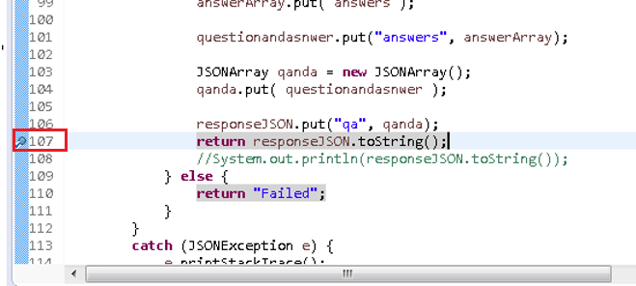
Output – a blue dart icon appear next to the line
Java Plays: Remote Development and Debugging using Eclipse

Slide 16
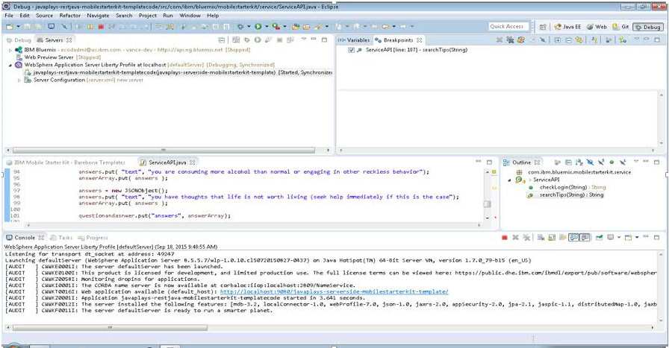
Step 5: Test Local Debug Session
Switch to Debug Perspective
Java Plays: Remote Development and Debugging using Eclipse

Slide 17
Open Postman extension page in Chrome browser
Change to POST method
Enter http://localhost:9080/javaplays-serverside-mobilestarterkit-template/api/service/searchtips
Click Body tab
Select raw
Enter the following
  {
  “question” = “depression”
  }
Click Send
Java Plays: Remote Development and Debugging using Eclipse

Slide 18
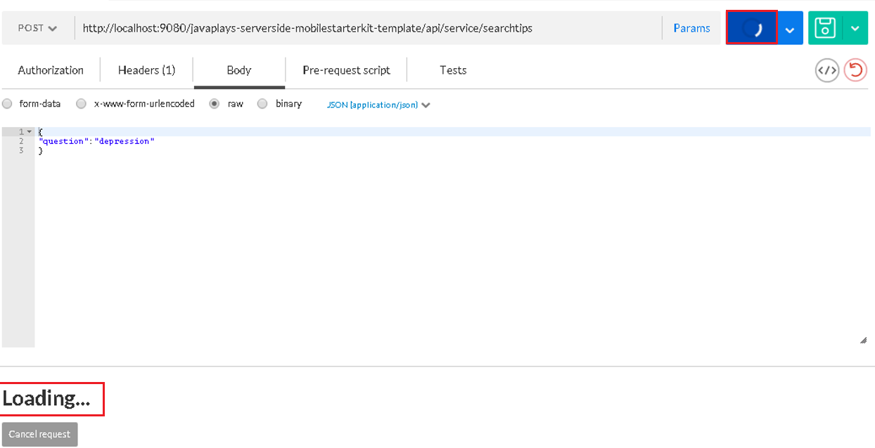
Output – loading icon
Will continue to load until we go back to Eclipse to resume the process
Java Plays: Remote Development and Debugging using Eclipse

Slide 19
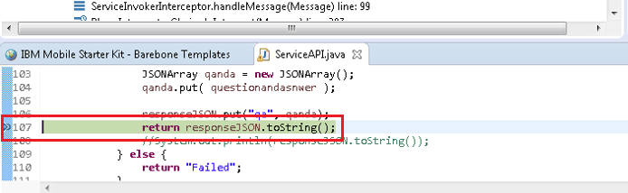
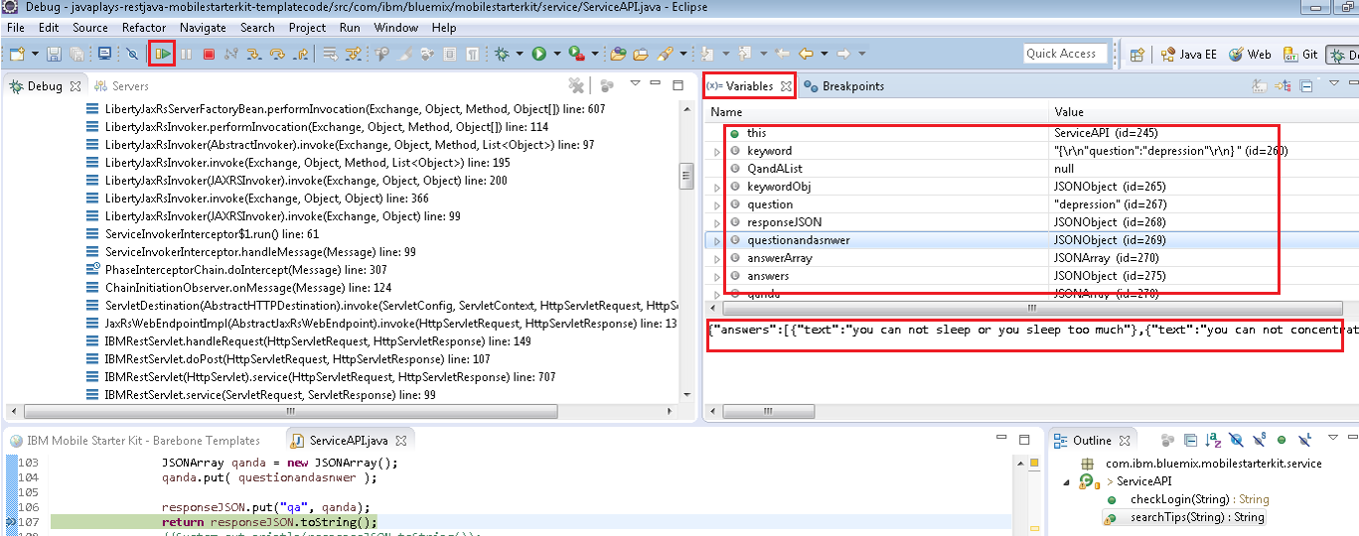
Back to Eclipse, the line with breakpoint is highlighted
In Variables view, validate the variables and their values
2 ways to resume the operation:
  Click Resume icon
  Press F8
Java Plays: Remote Development and Debugging using Eclipse

Slide 20
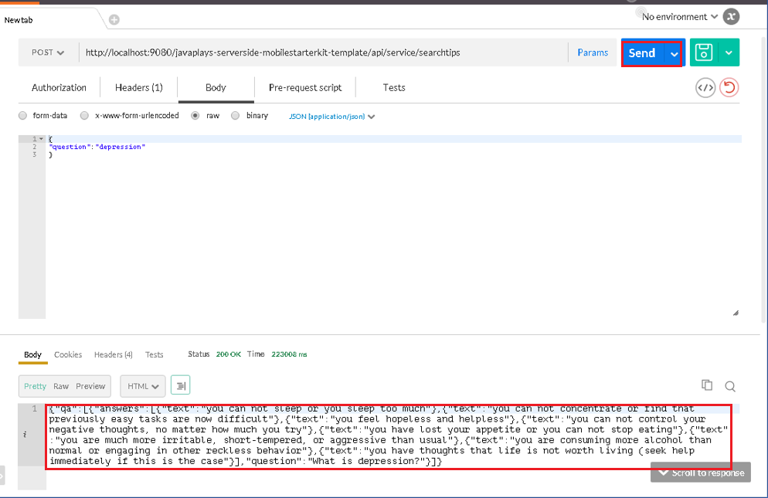
Output – loading icon turns to Send button, and results displayed
Java Plays: Remote Development and Debugging using Eclipse

Slide 21
Summary
In this lab, you learned how to enable remote development mode, which allows incremental pushes to Bluemix server using the Eclipse Bluemix Plugin. The same can be achieved by using DevOps to edit, commit, build and deploy the changes.
We also learned to start the local WebSphere Liberty server in debug mode, which allows us to trace errors by validating every single available variable.
Remote debugging in Bluemix server work in a similar way. We need to Enable application debug, a menu available when you right click on Bluemix server, in Servers view. For more information, please refer to the link below:
https://www.ng.bluemix.net/docs/manageapps/eclipsetools/eclipsetools.html
Java Plays: Remote Development and Debugging using Eclipse

Slide 22
This ends the Eclipse Lab 3 Local Debugging and Remote Development
Thank you !
Java Plays: Remote Development and Debugging using Eclipse

